Slide 1
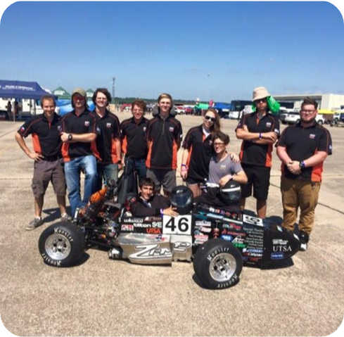
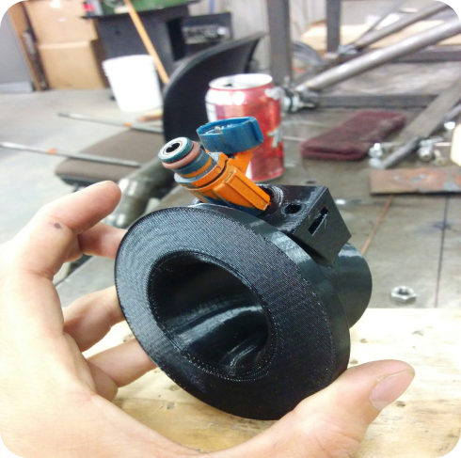
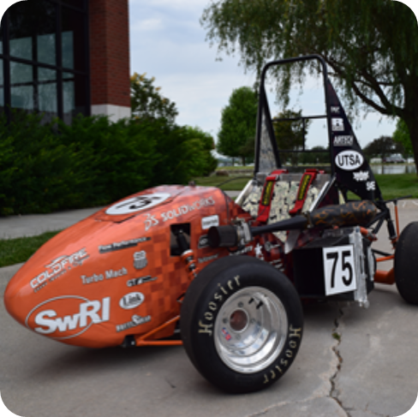
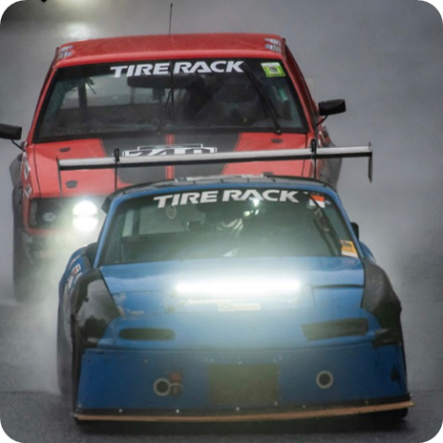
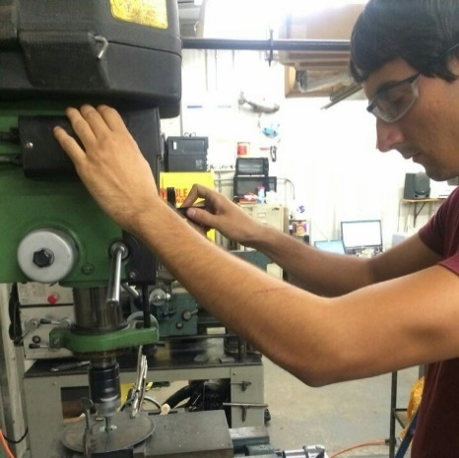
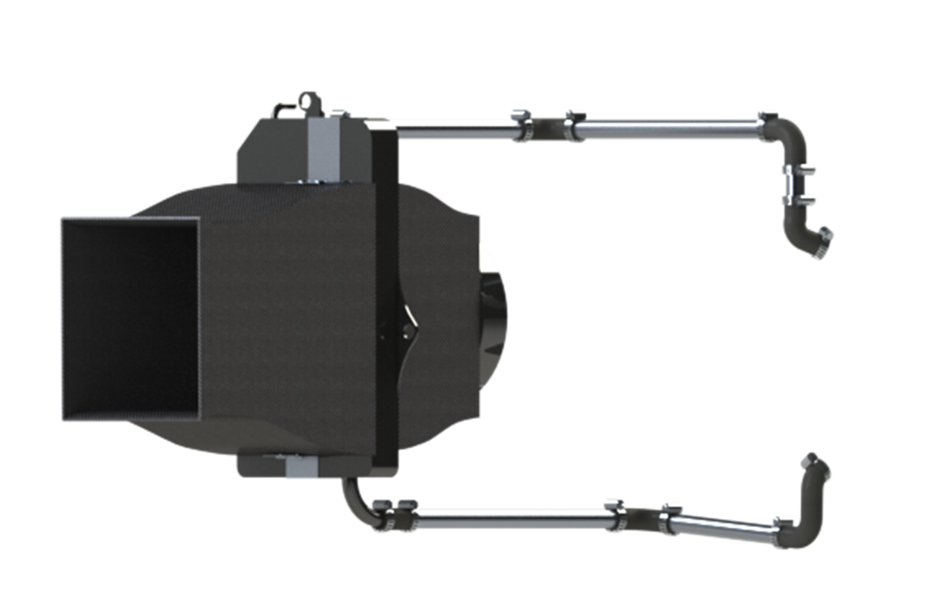
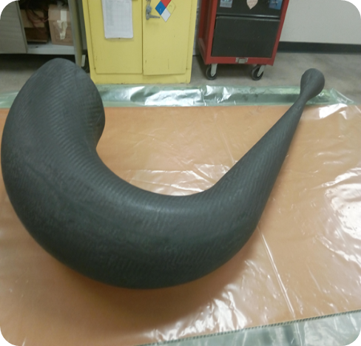
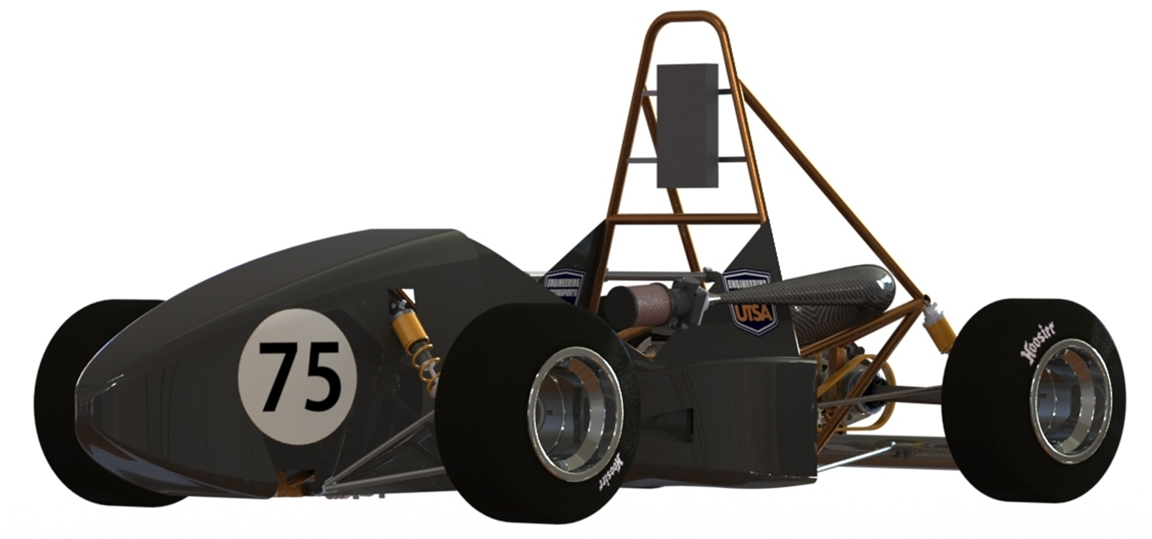
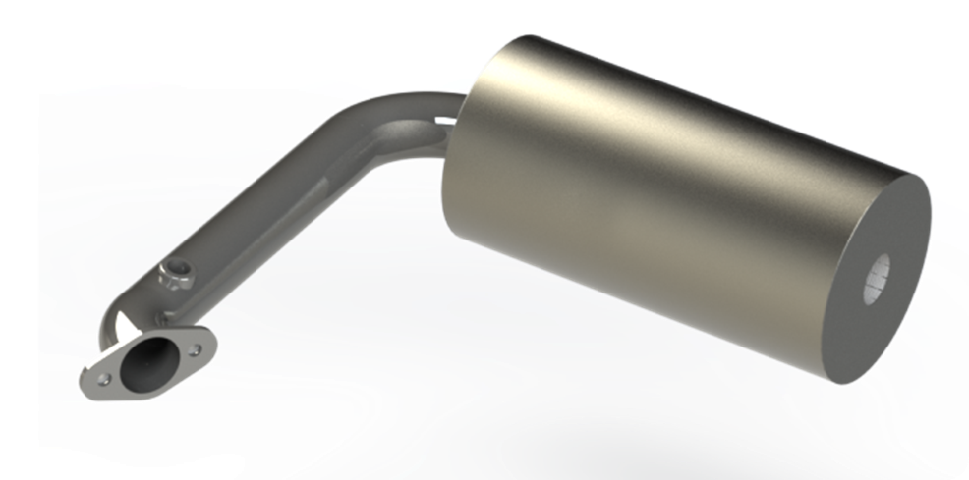
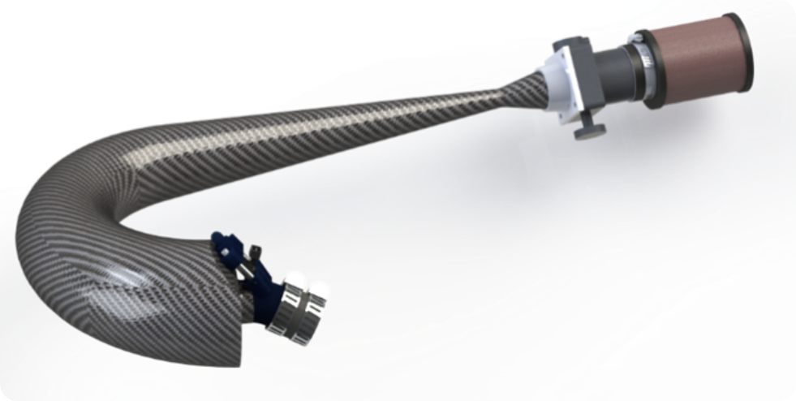
MECHANICAL ENGINEERING PORTFOLIO of NICHOLAS LOVE

Slide 2

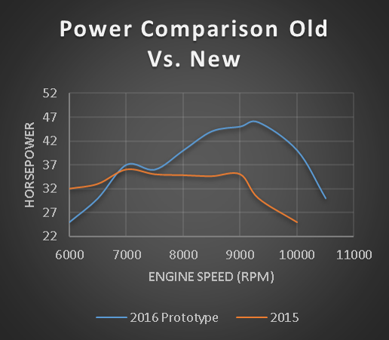
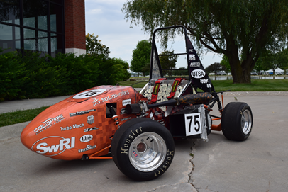
Product Development Engineer
As Powertrain Lead, I was tasked with finding problems with the previous system and increasing the power output. I used 1-Dimensional Gas Dynamic Software (Ricardo Wave) to analyze changes in geometry throughout the intake system. I created 100+ parametric simulations evaluating adjustable runner length, plenum volume, bend radii, air-fuel ratio, compression ratio, internal roughness, and valve timing. SolidWorks Flow Simulation was used to increase the efficiency of the mandatory 20mm diameter restriction and a converging-diverging nozzle was chosen to increase pressure recovery. The intake runner and restrictor section were 3D printed out of Ultem 9085 while the intake plenum was manufactured out of fiberglass using two custom male molds. The 2016 Powertrain system made 46.9 horsepower which was a 25% improvement over the previous year.
Product Development Engineer: Flowbelow
Top Left — 3D printed Ultem 9085 intake runner which has an injector mount for ideal spray on back of intake valves. 150 mm length chosen to make peak power at 11,000 RPM. Top Right — Parametric study from Ricardo Wave on intake runner length. Shows how the timing of pressure waves can have an effect on the shape and magnitude of the horsepower curve. Bottom Left — Dynamometer comparison of 2015 and 2016 Formula cars. Shows a 25% increase in peak horsepower in operational range of engine at competition (6500-10000 RPM). Bottom Right — Left side of 2016 UTSA Formula SAE car showing full intake system.

Slide 3
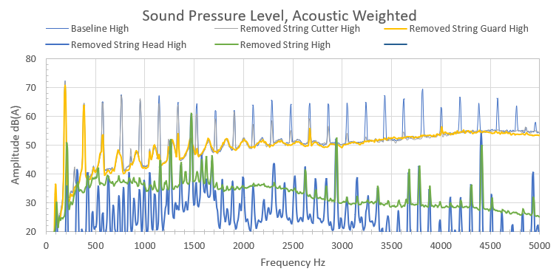
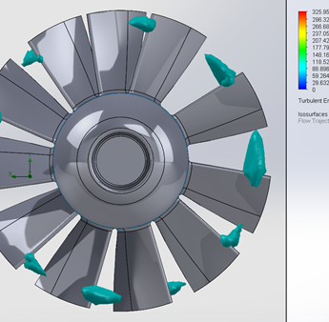
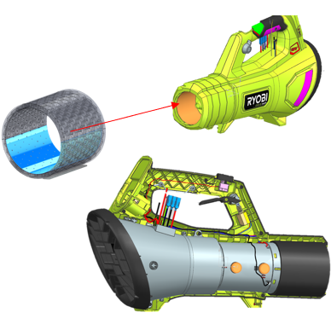
Advanced Concept Development Engineer:
Techtronic Industries
The goal of this project was to evaluate current electric blowers, hedge trimmers, chainsaws, polesaws, and string trimmers and create concepts to reduce the sound pressure level.
The project was sectioned to first evaluate baseline performance of products, evaluate contribution of specific sources of noise, note transmission paths to the receiver, develop concepts specific to each product, rapid prototype components, and complete testing to validate designs.
Finalized prototypes had a reduction of sound pressure level of 5-10 dB(A) utilizing technology that limits a reduction in performance. Design calculators and 30+ page report was created to pass on knowledge to current project engineers to work toward.
Top — Fast Fourier Transform sound testing data of 40V String Trimmer in semi-anechoic chamber. Bottom Left — Iteration of an axial fan design utilizing asymmetric blades and reviewing isosurfaces of Turbulent Kinetic Energy (TKE).
Bottom Right — Helmholtz resonator design to attenuate blade pass frequency and other trouble frequencies in 40V Handheld Blower.

Slide 4
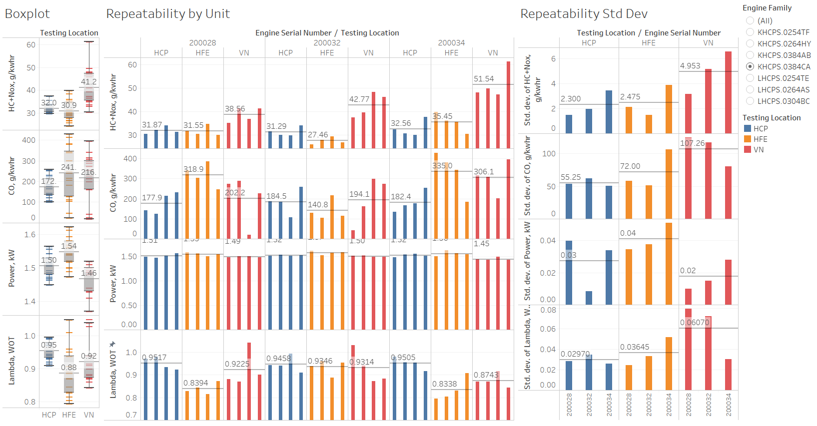
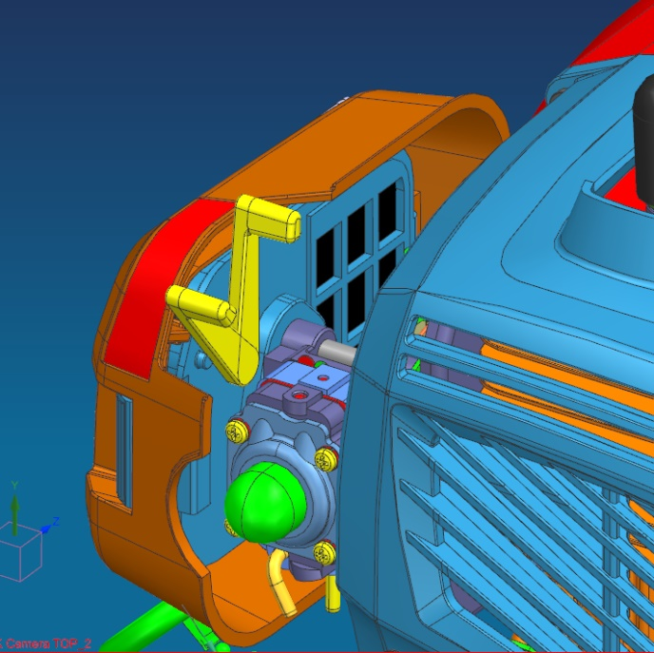
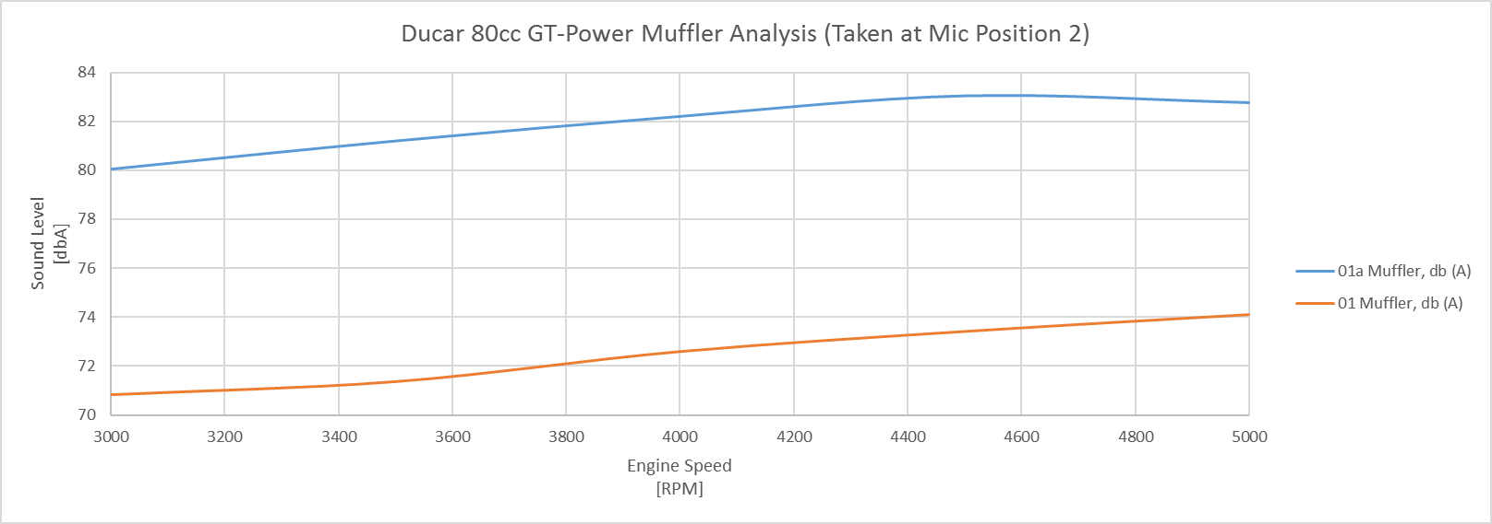
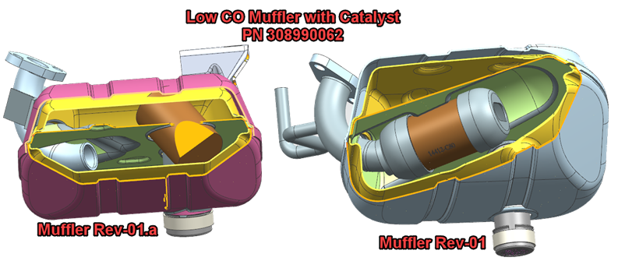
Project Engineer III:
Techtronic Industries
Led over 60 projects of varying size, scope, and priority throughout the year. Three projects shown here will be discussed as an example of the work done.
Tariffs led to a new manufacturing facility to be created in Vietnam and the production and emissions/power evaluation. I was tasked with validating the process from component acquisition, assembly, carburetor setting, emissions and power validation, and quality control of these processes.
Utilized GT-Power Engine Gas Dynamic software to create engine models of all current engines as well as partnered with the generator group to compare two different complex muffler designs they received from the vendor and provide feedback on potential upgrades.
Top — Tableau dashboard created to evaluate power and emissions data from the transition to manufacturing from China to Vietnam . Bottom Left — Intake Assembly designed to accommodate a fixed jet carburetor with onboard throttle lever.. Bottom Right — Collaborative project with the Generator group using GT-Power to evaluate muffler designs.

Slide 5
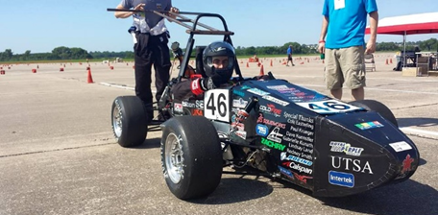
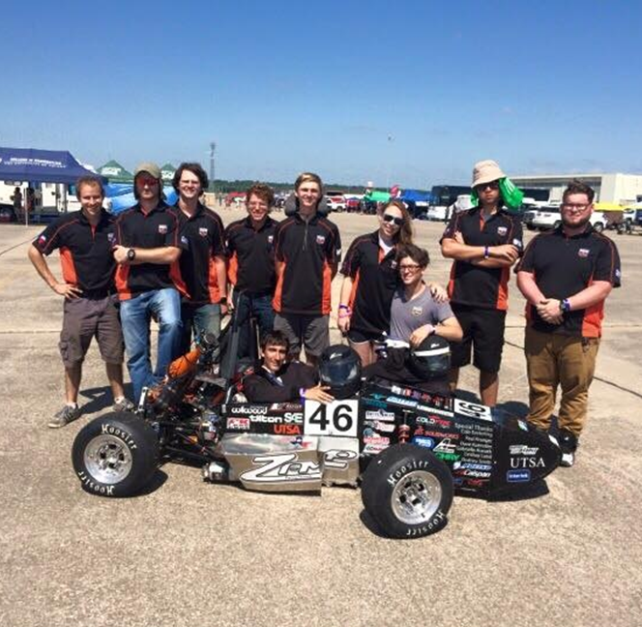
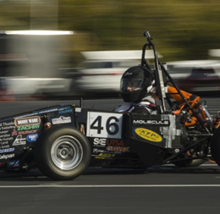
2015 UTSA Formula SAE Powertrain System
Overview
With limited budget constraints for the 2015 UTSA FSAE car, the goal of the powertrain system was to create a reliable starting system, good fuel and ignition mapping, and a cooling system to keep the engine in thermal equilibrium during events.
Personal Role
I began working with UTSA FSAE by helping assist with basic fastening, engine diagnostic and repair, and general tasks. I began designing the Intake Manifold at this time although due to budget constraints, we were not able to proceed with manufacturing. I became the primary engine control unit tuner and focused on creating a reliable start sequence and idle. I collected recorded data logs from driving the car and tuned for the ideal air-fuel ratio (12.8:1). I was one of two drivers to drive at competition and was the first driver in UTSA FSAE history to finish the endurance race. Our team finished 17th overall out of 80 universities.
Top — Picture after I finished driving the endurance portion at competition. Bottom Left — Team picture in Lincoln, Nebraska at competition.
Bottom Right — Driving 2015 car at an autocross in Arlington, Texas.

Slide 6
2016 Formula SAE Intake Manifold
As Powertrain Lead, I was tasked with finding problems with the previous system and increasing the power output. I used 1-Dimensional Gas Dynamic Software (Ricardo Wave) to analyze changes in geometry throughout the intake system. I created 100+ parametric simulations evaluating adjustable runner length, plenum volume, bend radii, air-fuel ratio, compression ratio, internal roughness, and valve timing. SolidWorks Flow Simulation was used to increase the efficiency of the mandatory 20mm diameter restriction and a converging-diverging nozzle was chosen to increase pressure recovery. The intake runner and restrictor section were 3D printed out of Ultem 9085 while the intake plenum was manufactured out of fiberglass using two custom male molds. The 2016 Powertrain system made 46.9 horsepower which was a 25% improvement over the previous year.
Top Left — 3D printed Ultem 9085 intake runner which has an injector mount for ideal spray on back of intake valves. 150 mm length chosen to make peak power at 11,000 RPM. Top Right — Parametric study from Ricardo Wave on intake runner length. Shows how the timing of pressure waves can have an effect on the shape and magnitude of the horsepower curve. Bottom Left — Dynamometer comparison of 2015 and 2016 Formula cars. Shows a 25% increase in peak horsepower in operational range of engine at competition (6500-10000 RPM). Bottom Right — Left side of 2016 UTSA Formula SAE car showing full intake system.

Slide 7
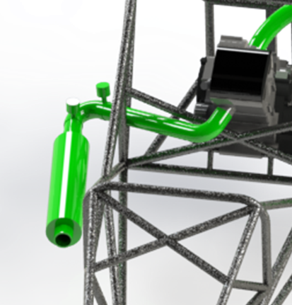
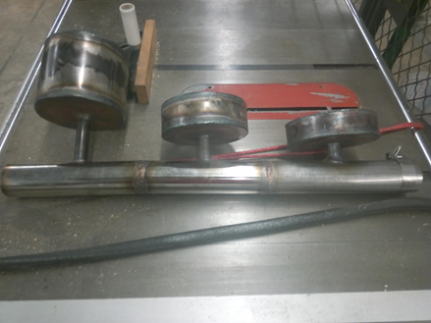
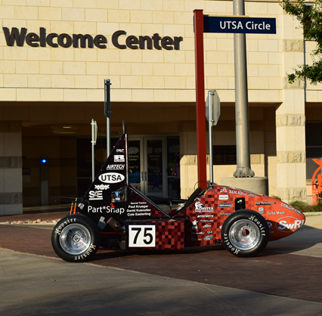
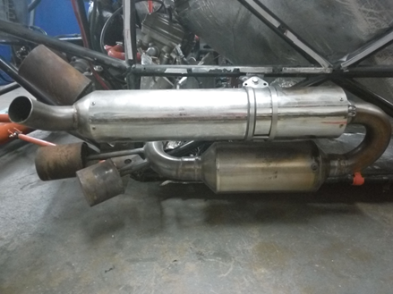
2016 Formula SAE Exhaust Manifold
During previous years, UTSA has had difficulties in meeting sound requirements with single cylinder engines. I was tasked to create an exhaust that met sound requirements while minimizing back-pressure. I used Helmholtz resonator theory as a way to target the engine’s fundamental frequencies. Once the resonators were designed, I imported them into 1-Dimensional Gas Dynamic Software (Ricardo Wave) to measure estimated sound level. I created a prototype exhaust to verify the analytical results of the software. Once validated, our team manufactured the exhaust which met the stringent sound requirements of the Formula SAE competition.
Top Left — Initial SolidWorks concept of exhaust using two Helmholtz resonators and a straight-through muffler. Top Right — Proof of concept design for testing the attenuation and precision of Helmholtz resonators. Bottom Left — 2016 UTSA Formula SAE car which finished 30th at competition in Lincoln, Nebraska. Bottom Right — 2016 exhaust manifold housing three Helmholtz resonators and two straight-through mufflers. This exhaust design met the sound requirements at competition.

Slide 8
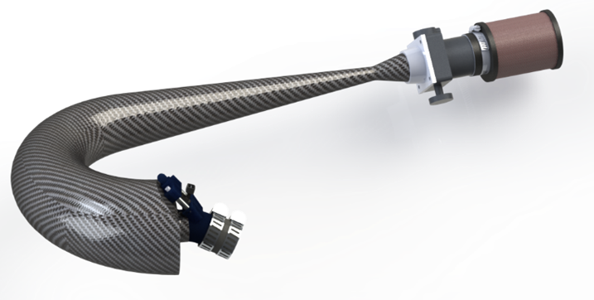
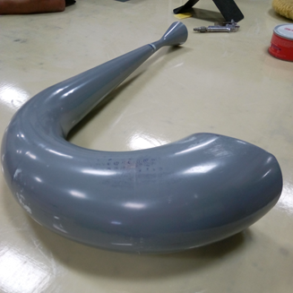
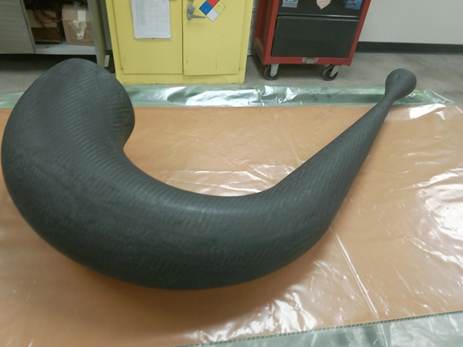
2017 Formula SAE Intake Manifold
I utilized my previous experience with the 2016 intake to optimize th design. I created an Excel spreadsheet with macros to analyze head loss. The two main drawbacks of the previous design were weight and the internal surface finish so I decided to use carbon fiber and focus on our mold preparation techniques. A male mold was created from 3D-printed ABS to ensure proper geometry and was finished with Bondo and finishing primer. The finished intake reduced weight from the previous design by 7.5 pounds and increased peak horsepower by over 10%.
Top — SolidWorks model final render of 2017 UTSA Formula SAE intake manifold. Bottom Left — Final male mold made of interconnecting 3D-printed ABS pieces. Bottom Right — First lay-up of carbon fiber on male mold.

Slide 9
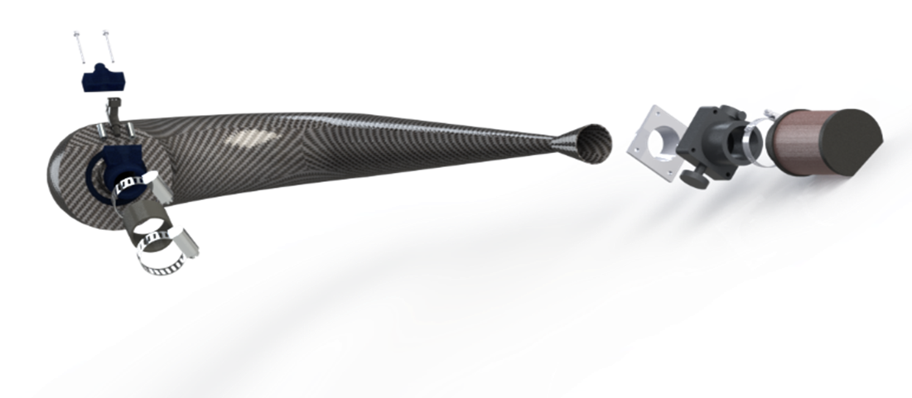
◆
❖
⬥



2017 Formula SAE Intake Manifold
Design Intent
◆ Injector cap adapter for use in adapting an AN fitting to an injector with an o-ring.
❖ This intake runner was designed with many purposes. The length was chosen to allow for dynamic supercharging at a chosen engine speed while the transition between the intake plenum and runner was chosen as a compromise between head loss and ability for pressure wave reflection. Houses an injector mount which allows injector to spray directly on back of valves..
⬥ A larger plenum volume increases power both by allowing the engine to pull from a reservoir of air instead of pulling through the mandatory restrictor as well as acting as a buffer to pressure waves propagating through the restrictor decreasing flow..
 Diffusing angle required to recover from pressure loss due to restriction.
 Mandatory restrictor of 20mm inside a converging – diverging nozzle..
 Custom 6061-T6 aluminum flange to adapt the composite intake to the throttle body.

Slide 10
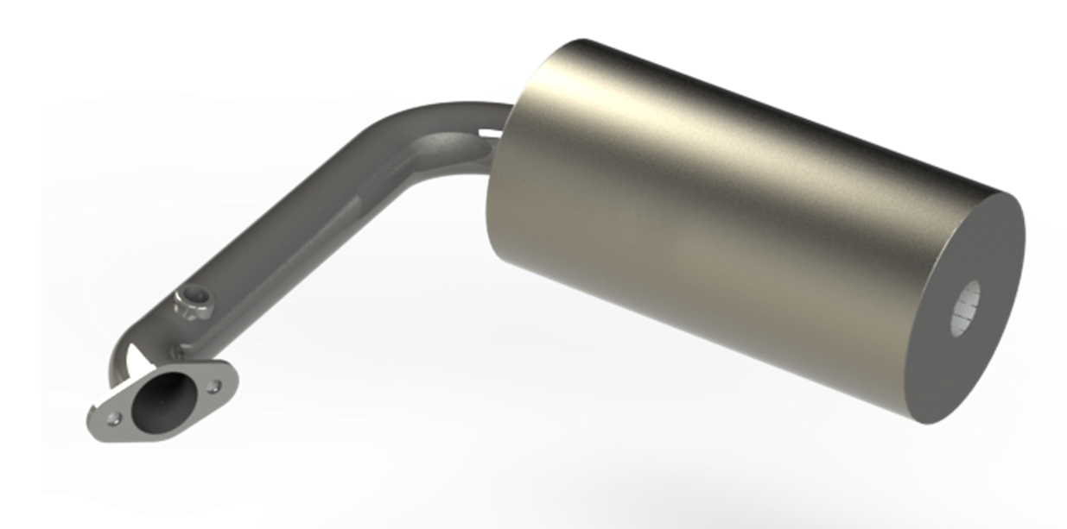
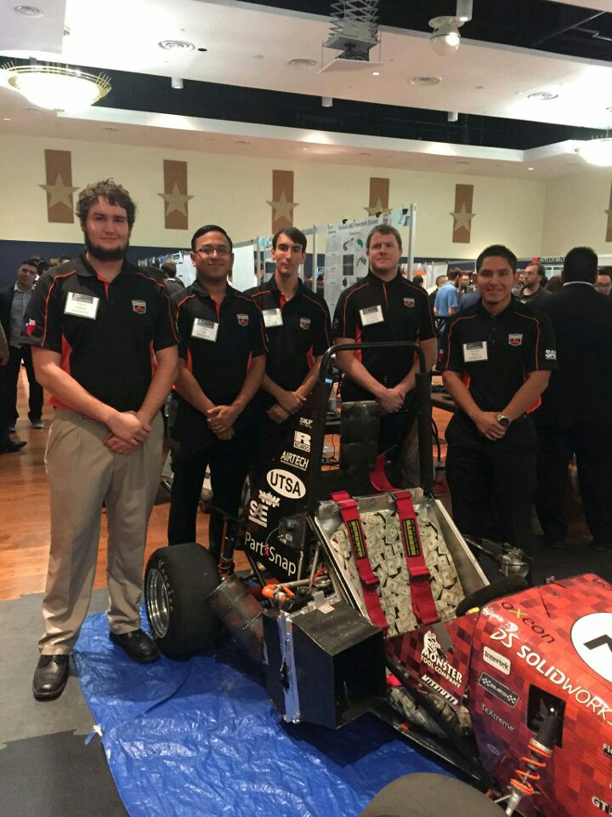
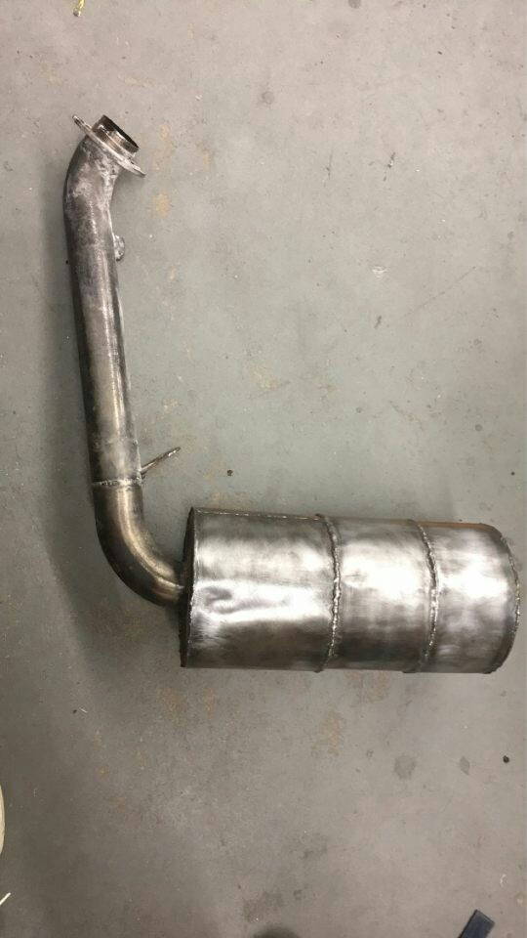
2017 Formula SAE Exhaust Manifold
The purpose of this project was to create a lightweight exhaust which could meet the stringent sound requirements by Formula SAE while minimizing back pressure. I utilized previous experience with exhaust design and incorporated two Helmholtz chambers inside to target two fundamental engine frequencies. Exhaust primary length was chosen to allow for dynamic scavenging. (Allowing for the exhaust valves to have a region of low pressure when they open to “pull” air out of the combustion chamber)
Top — Final render of exhaust manifold assembly for 2017 UTSA Formula SAE car. Bottom Left — Senior design group which focused on the entire Powertrain system. Bottom Right — Exhaust manifold manufactured with both 304 stainless steel and 1018 mild steel. Exhaust was back-purged with Argon to avoid weld penetration on the inside surface to minimize head loss.

Slide 11
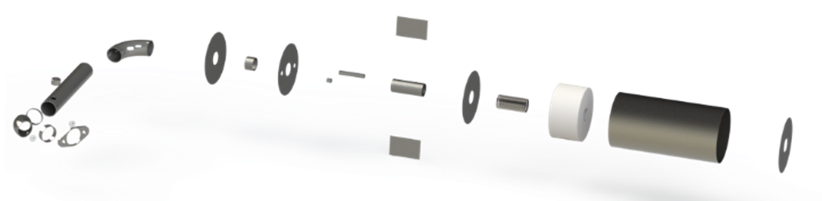


2017 Formula SAE Exhaust Manifold
Design Intent
⬥
◆ 304-Stainless Steel chosen for water jet flange and primary runner due to its higher yield strength at high temperatures while 1018 mild steel was chosen for the muffler components.
❖ O2 bung for Oxygen Sensor. Feedback for engine control unit (ECU) to adjust fuel and ignition timing from air-fuel ratio.
⬥ Primary length of exhaust chosen to allow for dynamic scavenging events (region of low pressure when the exhaust valve opens to “pull” air out of the combustion chamber) to occur at the proper engine speed.
 Internal chamber housing two Helmholtz resonators. Each pipe length was chosen to target an engine fundamental frequency.
 Perforated core with fiberglass packing around to absorb higher frequency sound.
❖
◆

Slide 12
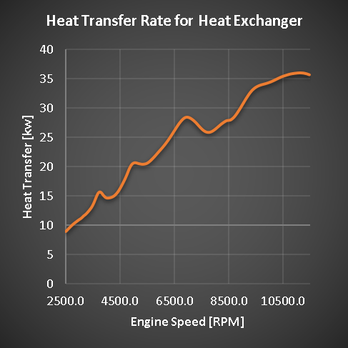
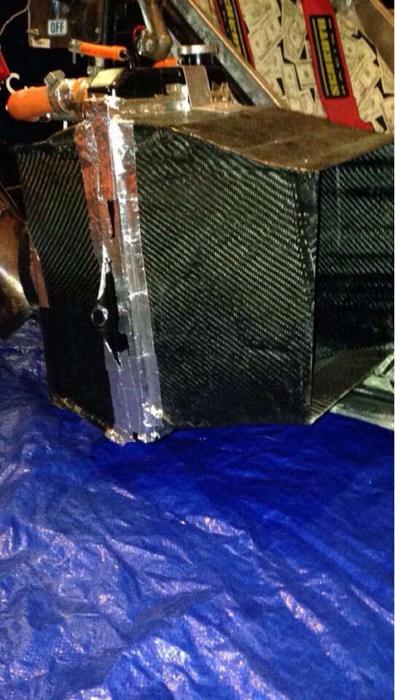
2017 Formula SAE
Cooling System
This cooling system was another component which our senior design group focused on. Previous UTSA Formula SAE teams have had issues with overheating at competition so a large focus was put on creating a lightweight cooling system that could keep the engine in thermal equilibrium. I used Ricardo Wave to record the fuel mass flow rate of the engine and used this data to determine how much heat would need to be dispelled from the coolant. To validate this I created an Arduino-based data acquisition device to record temperatures of both the coolant and used this data to size the heat exchanger. 3K Twill carbon fiber was chosen for the ducting material to keep this system as lightweight as possible.
Top — 3D SolidWorks model render of the cooling system. Bottom Left — Heat transfer rate that cooling system needed to dispel at each engine speed. Bottom Right — Final manufactured cooling system.

Slide 13
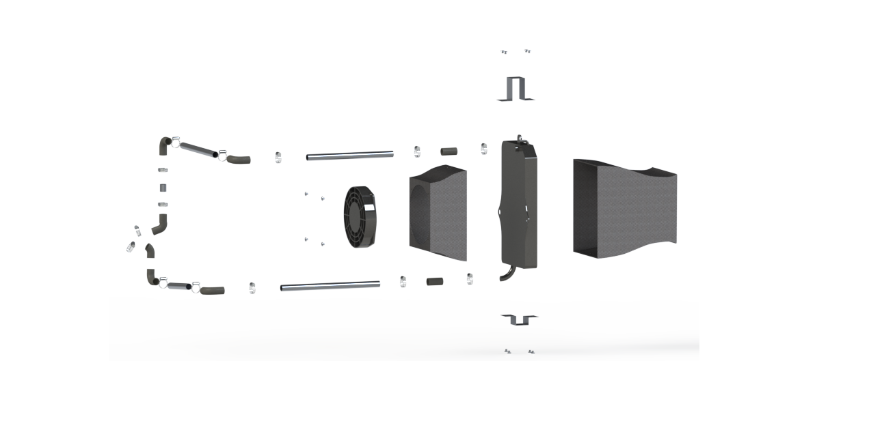

❖
◆
⬥


2017 Formula SAE Cooling System
Design Intent
◆ Diverging nozzle design allows for a high pressure region on the front of the heat exchanger to create a greater mass flow rate and a greater heat transfer rate as a result. Manufactured with 3K Twill carbon fiber for its lightweight and ease of manufacture.
❖ Heat exchanger area chosen through Effectiveness-NTU method and through simulation in Ricardo Wave.
⬥ Converging nozzle design works in consort with the front diverging design to generate the greatest pressure differential. Mounting created for fan to rivet on and ensure that all air must pass through the fan..
 6061-T6 aluminum mounts were created to rivet onto carbon fiber radiator ducts to ensure positioning if car impacted a cone.
 High-flow fan was chosen to achieve the desirable volumetric flow rate while minimizing amp draw on the electrical system.
 6061-T6 aluminum tube was used due it being lighter than silicone couplers as well as its ability to transfer a small amount of heat out of the coolant..

Slide 14
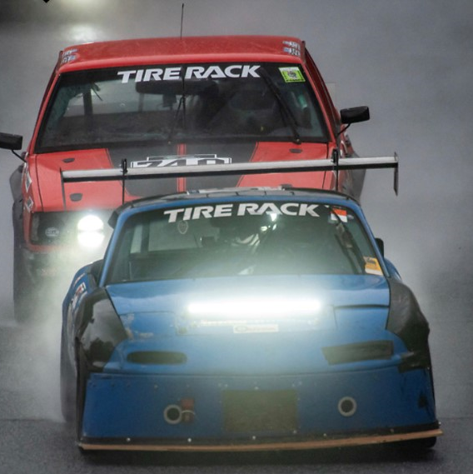
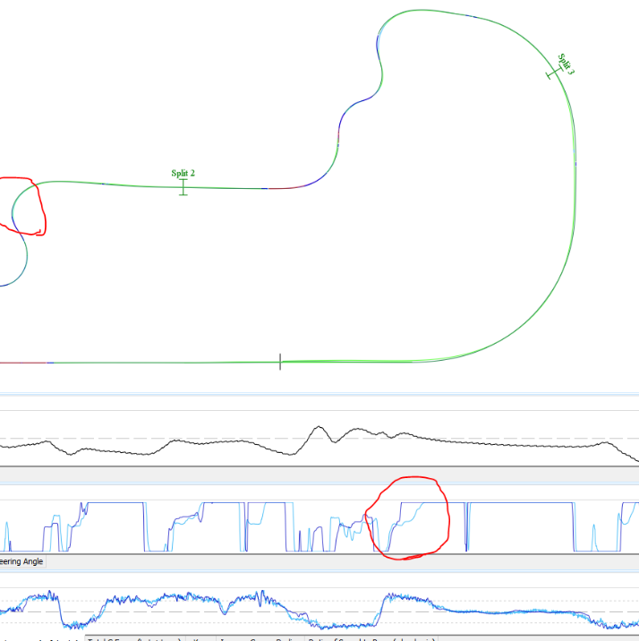
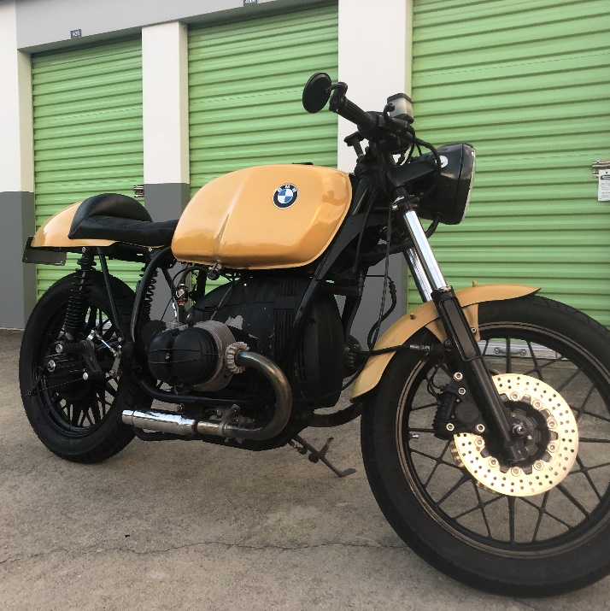
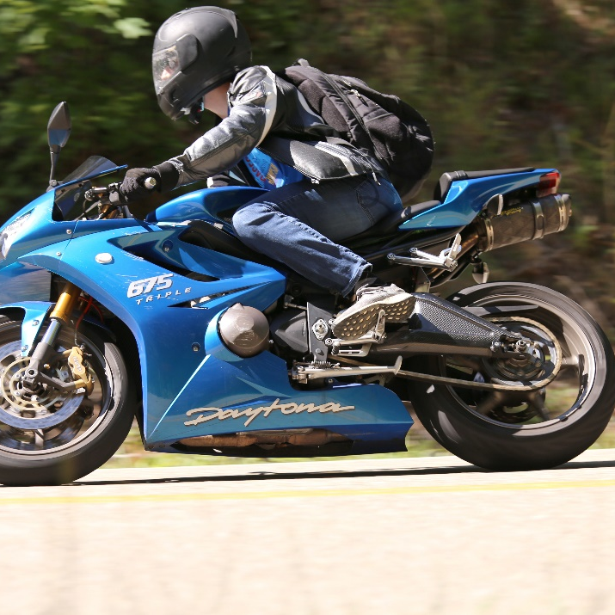
Hobbies and Personal Interests
Ever since I was young I knew that I wanted to get into Mechanical Engineering and race cars, and I’ve been lucky enough to do both these last few years. I’m the team captain and owner of Love Racing who compete in 3-4 races each year in the Champcar Endurance Series with my best friends. We now have two cars and race at premier tracks across the country including Virginia International Raceway, Road Atlanta, Sebring, and more! I’ve built a sim racing computer rig to the specs of our race car with virtual reality to closely simulate our races. Now our whole team race together online when not racing in real life and we can evaluate telemetry and racecraft to better ourselves.
I’m also active in motorcycle riding and planning a trip to Alaska later this year!
Top Left — Battling for P1 overall at a race at Barber Motorsports Park in the rain (2021) Top Right — Evaluating telemetry data between different team members to determine where time is being lost. Bottom Left — 1983 BMW R100 that I restored into a café racer style bike.. Bottom Right — Riding my Triumph Daytona at the Tail of The Dragon.

